Slide 1
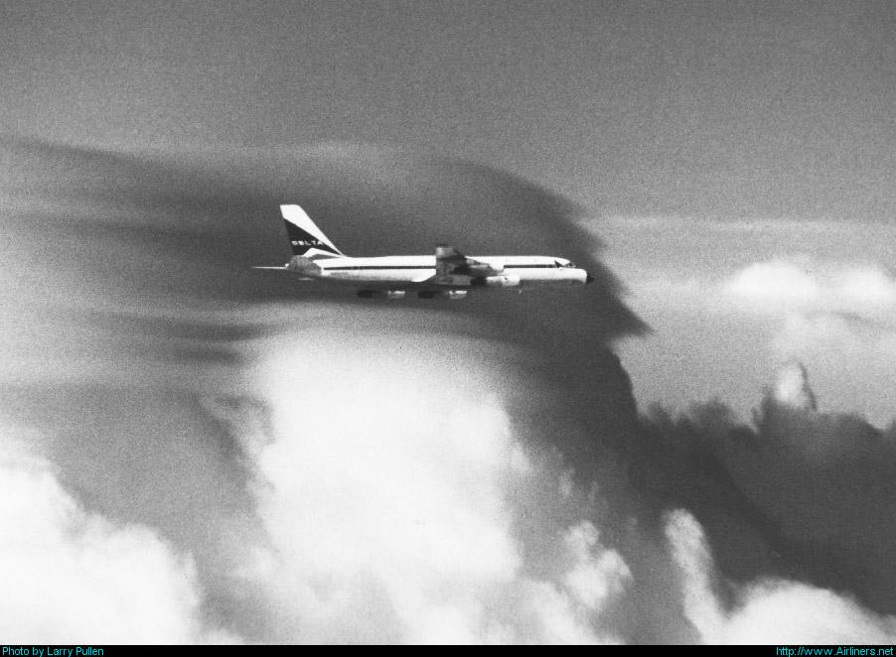
VI. Weather phenomena affecting aircraft performance
Notes:
VI - <number>
Issue 1 – Feb 2011
VI – Weather phenomena affecting aircraft performance
This section presents the influence of weather phenomena on aircraft performance, with some focus on effects of wind and temperature gradients.

Slide 2
1. Weather phenomena
Turbulence
  Wind gusts
  Wake turbulence
Wind gradients : wind shear, microbursts
Temperature gradients
Icing
Lightning strikes
Notes:
VI - <number>
Issue 1 – Feb 2011
VI – Weather phenomena affecting aircraft performance
This slide presents some weather phenomena that may affect aircraft performance, handling qualities or which may be hazardous.
Turbulence is the consequence of wing gusts which induce load factor variations (cf. next slides). Wake turbulence may produce high roll rotation rates which may induce loss of control.
Wind and temperature gradients are presented in the next slides.
Icing may have several consequences :
False anemometric indications due to pressure ports icing.
Airframe icing, affecting performance due to high drag and increased stall speeds (lower maximum lift coefficient).
Powerplant icing which may lead to engine failure (piston engines are prone to carburetor icing).
Airplanes able to fly in instrument conditions must be protected against lightning strikes, which are a potential hazard to aircraft systems as well as structure (composite materials may be damaged by lightning strikes and must be covered by metallic paint to avoid such damages).

Slide 3

1. Weather phenomena
Notes:
VI - <number>
Issue 1 – Feb 2011
VI – Weather phenomena affecting aircraft performance
Cumulonimbus present a potential threat to aviation safety, since they may produce several hazardous phenomena :
Strong winds
Wind gusts, with risks of severe turbulence
Low level wind shear or microburst
Hail, which is potentially damaging for airframe (leading edge, radome, cockpit windows)
Heavy rainfall, reducing visibility, and potentially contaminating runway with standing water
Icing (at higher altitudes)
Lightning strikes

Slide 4
2. Influence of wind gradients
Gust penetration
When a sudden wind gust is encountered :
  Ground speed does not vary initially,
  Airspeed varies according to gust intensity,
  As a consequence, load factor varies,
  Ground speed evolution results from forces equilibrium.
Notes:
VI - <number>
Issue 1 – Feb 2011
VI – Weather phenomena affecting aircraft performance
A wind gust is a sudden variation of wind direction and/or intensity. In reality, a gust is a strong wind gradient, the wind varying according to the time or in the space.
Forces equation may be written as follows :
Ground speed is the sum of airspeed and wind :
A sudden wind gust may be represented as an instantaneous wind increment. If a sudden gust is encountered in stabilized flight when forces equilibrium is achieved, there is no direct impact on ground speed, as a consequence, airspeed increment is :
Airspeed increment has consequences on aerodynamic forces through kinetic pressure (horizontal gust) and angle of attack (vertical gust). This has consequences on load factor and on ground speed evolution.

Slide 5
2. Influence of wind gradients
Penetration in a vertical gust
Level flight
n_{z} ≅ 1
Stabilized climb
n_{z} ≅ 1
Transition
ΔZ ≅ q S Cz_{α} Δα
Δn_{z} = ΔZ/mg
γ_{k} = Wz/V
Vk
Vk
Constant thrust
and CAS
Wz
Wz
V
V
Δα ≅ Wz/V
γ_{k} ≅ Wz/V
Notes:
VI - <number>
Issue 1 – Feb 2011
VI – Weather phenomena affecting aircraft performance
This slide presents a vertical gust encounter from stabilized level flight.
When vertical gust Wz is encountered, this produces an opposite airspeed increment. Since pitch attitude is unchanged, this airspeed increment produces a positive angle of attack increment. The consequence of this positive angle of attack increment is a positive normal load factor increment.
As a result of the positive load factor increment, climb angle increases.
If CAS and thrust are maintained, aircraft stabilizes in climb at constant vertical speed Wz.
The consequences of a vertical gust may be summarized as follows :
The short term effect is a normal load factor increment.
The long term effect is a vertical speed increment.

Slide 6
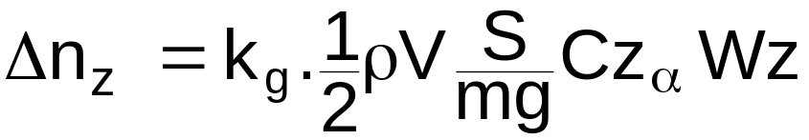
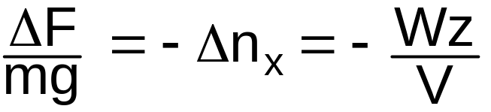
2. Influence of wind gradients
Influence of vertical gusts on performance
Load factor increment due to vertical gust (vertical wind Wz)
  k_{g} is a gust alleviation coefficient (lower than 1)
Thrust increment to maintain level flight within an uniform updraft (or downdraft)
Notes:
VI - <number>
Issue 1 – Feb 2011
VI – Weather phenomena affecting aircraft performance
At constant true airspeed, the lift increment due to a vertical gust may be expressed as follows :
K_{g} is a gust alleviation factor taking into account non stationary aerodynamic effects and Cz_{α} is the lift gradient.
Angle of attack increment is :
Note : FAR 25 § 341 gives a gust alleviation factor expression applicable to sinusoidal gusts.
From the expression for load factor increment, we may deduct that load factor increment increase with airspeed, air density, lift gradient and decreases with wing loading.
Thrust increment to maintain level flight within an uniform downdraft results from the expression for tangential load factor in aerodynamic reference system.

Slide 7
2. Influence of wind gradients
Penetration in a positive horizontal gust
Zero wind component
Positive gust : Wx > 0
Wx
Vk
Vk
Vk
V
V
Wx
If thrust balances drag
n_{x} = 0
Positive gust means
airspeed loss
Notes:
VI - <number>
Issue 1 – Feb 2011
VI – Weather phenomena affecting aircraft performance
This slide presents a horizontal gust encounter from stabilized level flight.
When positive (tailwind increment) horizontal gust Wx is encountered, this produces an opposite airspeed increment, since ground speed remains initially constant.
To recover initial airspeed, thrust must increase to accelerate and increase ground speed.
It must be stressed that kinetic pressure decreases due to airspeed loss. To maintain straight horizontal flight, angle of attack must increase to maintain constant lift (equal to weight). As a result, drag increases and thrust must increase further to compensate for this drag increase, in addition to the thrust increase necessary to recover from the airspeed loss.

Slide 8
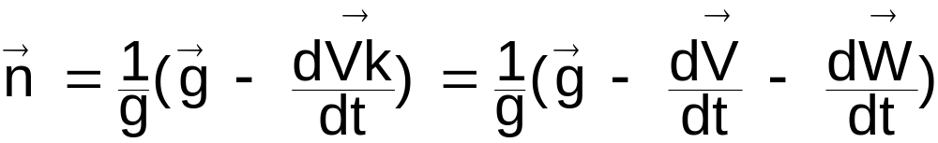
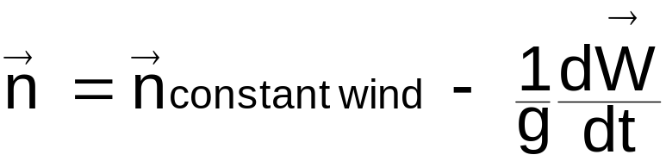
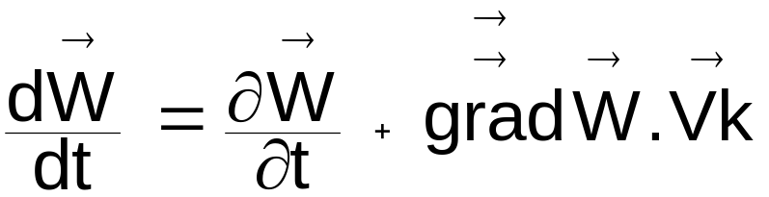
2. Influence of wind gradients
Load factor vector increment due to Wind gradient
Notes:
VI - <number>
Issue 1 – Feb 2011
VI – Weather phenomena affecting aircraft performance
In real atmosphere, wind does not change instantaneously. Wind varies according to space and time.
The acceleration vector is the addition of the time derivative of air velocity vector and time derivative of wind vector. Load factor vector may be expressed as a function of load factor at constant wind and wind gradient.

Slide 9
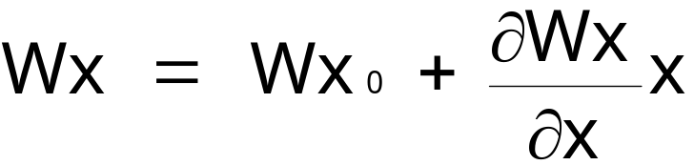
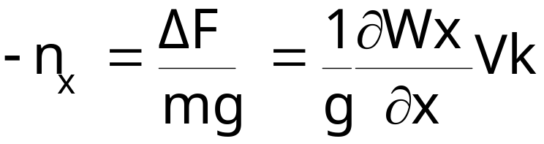
2. Influence of wind gradients
Horizontal wind gradients
Headwind/tailwind component (along x axis), varies as follows :
x is the horizontal distance
Thrust increment to maintain constant airspeed :
Notes:
VI - <number>
Issue 1 – Feb 2011
VI – Weather phenomena affecting aircraft performance
Assuming constant vertical and crosswind components, the effective wind (component along x axis) is supposed to vary according to the formula written on the above slide.
In horizontal flight, the expression for the longitudinal acceleration is :
To maintain a constant true airspeed V (i.e. constant IAS or Mach number, in level flight), acceleration must be :
As a consequence, longitudinal load factor increment to maintain constant airspeed, is:
Thrust increment to maintain constant airspeed is determined according to propulsion equation :
ΔF = - mg Δn_{x}
Note : This expression is applicable to horizontal flight, but may be extended to climb or descent, assuming a low value for flight path angle (cosγ_{a} = 1).

Slide 10
2. Influence of wind gradients
Horizontal wind gradients
To maintain constant airspeed when encountering an horizontal wind gradient :
  Thrust must be increased if the gradient is positive,
  Thrust must be decreased if the gradient is negative.
Thrust increment is proportional to :
  A/C weight,
  Ground speed,
  Gradient intensity.
Notes:
VI - <number>
Issue 1 – Feb 2011
VI – Weather phenomena affecting aircraft performance
The expression for thrust increment to maintain constant airspeed within a wind gradient is (cf. previous slide) :
According to this expression :
Thrust must increase to maintain constant airspeed when encountering a positive wind gradient (i.e. when tailwind component increases or headwind component decreases).
For given ground speed and wind gradient, thrust to weight ratio increment is constant : thrust increases with aircraft mass.
Thrust increment is proportional to ground speed, sum of airspeed and tailwind component. Fast and heavy airplanes, such as jet transports are more sensitive to wind gradients that light airplanes, which are slower.
Example : At its service ceiling, with a 300 ft/mn climb capability at Mach 0.8 (corresponding to a 0.65 % climb gradient), a jet airplane will be able to sustain a horizontal wind gradient corresponding to an equivalent longitudinal load factor increment (- 0.0065). Considering ISA temperature above 11 000 m and a zero initial wind component, this corresponds to a 2.68 10⁻⁴ s⁻¹ wind gradient, corresponding to 0.97 kt tailwind increment per nautical mile flown.

Slide 11
2. Influence of wind gradients
Low altitude wind shear and microbursts
Microburst are the most critical phenomena :
  Low altitude : close to the ground, low performance (T/O or landing configuration)
  Combines wind gradient and downburst
Notes:
VI - <number>
Issue 1 – Feb 2011
VI – Weather phenomena affecting aircraft performance
Wind gradients, or wind shear may be encountered at all altitudes, but low altitude microburst is one of the most critical weather phenomena affecting aircraft performance.
As presented on the above slide, the first indication of a microburst is a negative wind gradient : headwind component increase : thrust must be reduced to maintain airspeed.
Then downdraft increases and thrust must increase, and then wind gradient becomes positive : thrust must increase to maintain constant flight path angle as well as indicated airspeed, due to the downdraft and the positive wind gradient.
Low altitude microburst are critical for jet airplanes, due to several factors :
If thrust has been reduced to idle, several seconds are required to obtain take-off/go-around thrust (up to 8 seconds according to FAR/JAR 25).
High approach speeds and high wing loadings.
High drag in landing configuration.

Slide 12


2. Influence of wind gradients
Dry microburst
Wet microburst
Microbursts
Notes:
VI - <number>
Issue 1 – Feb 2011
VI – Weather phenomena affecting aircraft performance
This slide presents photographs of dry and wet microbursts.
A wet microburst is associated with heavy rain shower producing a severe downdraft which becomes an horizontal wind when hitting the ground.
A dry microburst is produced by rainfall from high tower cumulus in dry air. The raindrops evaporates and air temperature decreases due to evaporation, a cold air « bubble » forms and, descends due to its higher density. This produces a downdraft which becomes a horizontal wind when the « bubble » hits the ground.
Microbursts and other forms of low altitude wind shear may be dangerous. When encountering a low altitude wind shear, the escape maneuver consists in applying maximum thrust/power and increasing pitch attitude up to maximum angle of attack.
Several devices have been designed to detect low altitude wind shear as well as microbursts :
Reactive wind shear system, relying on airspeed and inertial data.
Systems based on multiple wind measurements on ground to detect horizontal gradients.
Systems based on wind velocity measurements by Doppler radars (ground based or onboard airplanes).

Slide 13
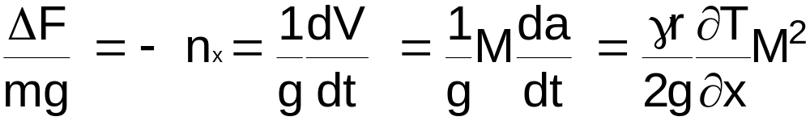
3.Temperature gradients
At constant altitude, constant Mach number is equivalent to constant CAS and constant EAS.
When temperature increases, thrust must increase to maintain constant Mach number (if wind is constant, ground speed increases).
Thrust increment to maintain constant Mach number when encountering a temperature gradient (zero wind) :
Notes:
VI - <number>
Issue 1 – Feb 2011
VI – Weather phenomena affecting aircraft performance
In straight and level flight, when a positive temperature gradient is encountered, the consequences are :
At constant engine rotation speed (propeller rpm or N1 on jet engines) a power/thrust decrement, due to lower air density.
A Mach number decrement due to sound velocity increases.
A Calibrated airspeed decrement which may be explained by the Mach number decrement at constant pressure altitude (Calibrated airspeed is a function of Mach number and pressure altitude). Air density decreases when temperature increases, and, as a consequence, equivalent airspeed will decrease at constant TAS.
Example : At its service ceiling, with a 300 ft/mn climb capability at Mach 0.8 (corresponding to a 0.65 % climb gradient), a jet airplane will be able to sustain a temperature gradient corresponding to an equivalent longitudinal load factor increment (- 0.0065).
According to the above formula, this corresponds to a 4.92 10⁻⁴ Kelvin/m temperature gradient, corresponding to 0.91 K temperature increment per nautical mile flown.

